Slide 1


FSM-Based Multi-Product Vending Machine using Verilog HDL

Slide 2
Introduction
A vending machine is a system that gives products when we put the correct amount of money. In this project, the vending machine is designed using a Finite State Machine (FSM) and implemented using Verilog HDL. It allows the user to select different products and insert coins. The machine gives the product when enough money is added and returns change if extra money is inserted. This system is useful in real-life applications.

Slide 3
Objectives
To design a vending machine using the Finite State Machine (FSM) approach
To support multiple product selection using control signals
To accept coin inputs and track the total inserted amount
To dispense the selected product when the required amount is reached
To return appropriate change for excess money inserted

Slide 4
Problem Statement
Design and implement a multi-product vending machine using Verilog HDL based on the Finite State Machine (FSM) approach.
The system should allow a user to select different products and insert coins, and it must dispense the selected product once the required amount is reached, while also returning change if excess money is inserted.

Slide 5
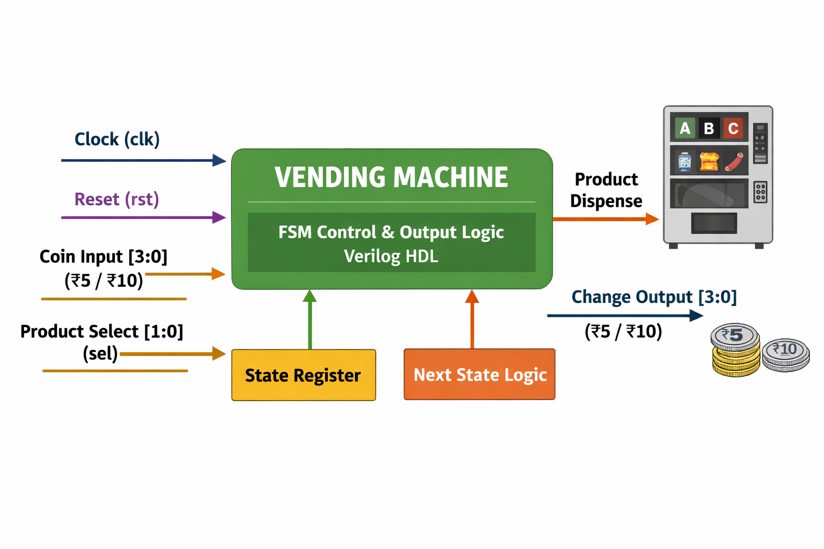
Block Diagram

Slide 6
System Specifications
The vending machine accepts coin inputs of:
₹5
₹10
The system supports multiple products with different prices:
Product A → Cost ₹10
Product B → Cost ₹15
Product C → Cost ₹20
A selection signal (sel) is used to choose the product:
sel = 0 → Product A
sel = 1 → Product B
sel = 2 → Product C

Slide 7
State Representation
Product A states:
A0, A5, A10, A15, A20
Product B states:
B0, B5, B10, B15, B20
Product C states:
C0, C5, C10, C15, C20, C25, C30

Slide 8
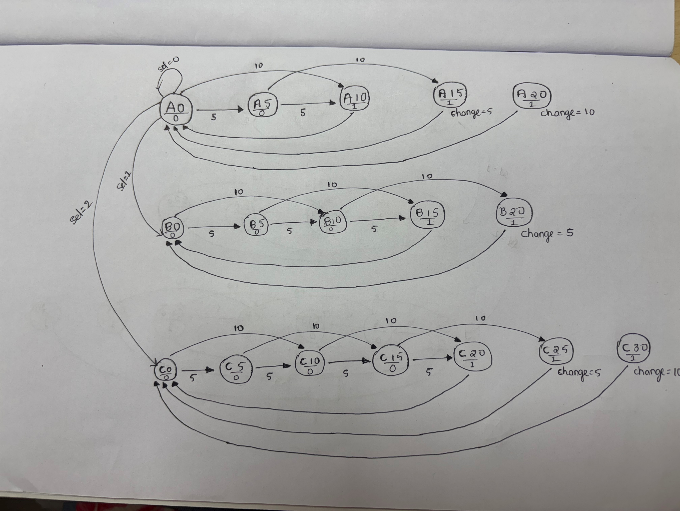

Slide 9
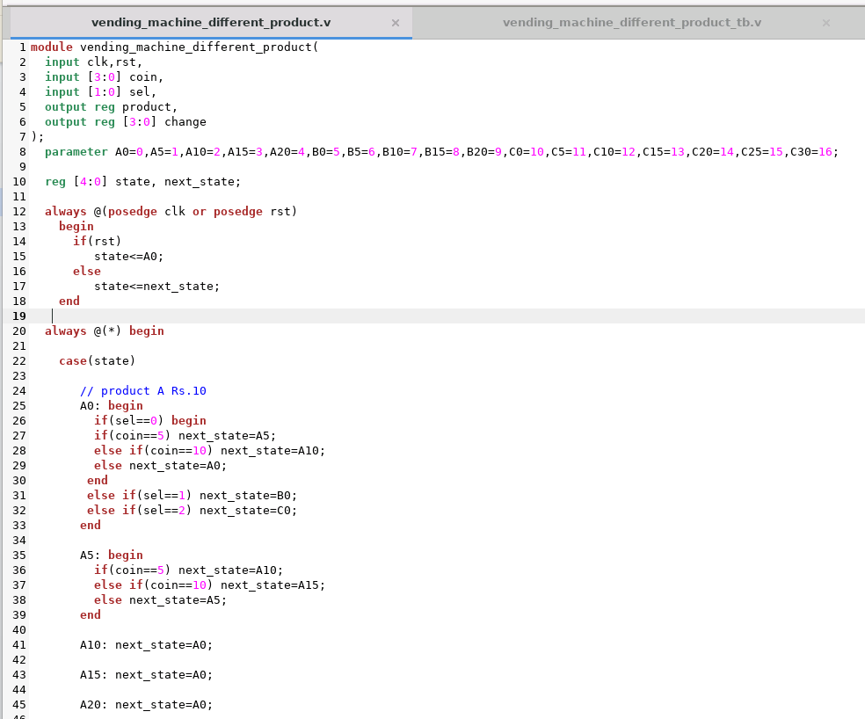
Design Code

Slide 10
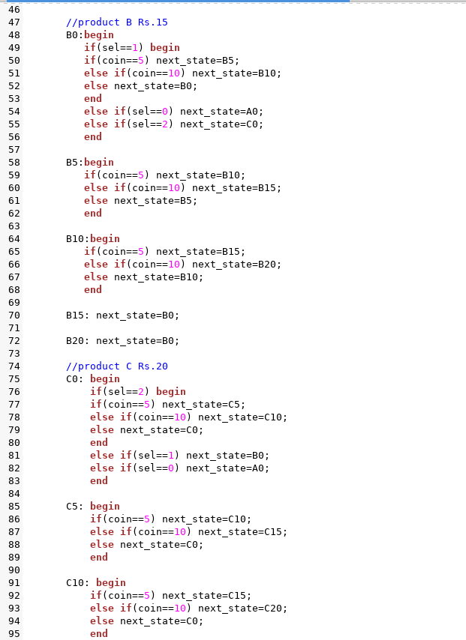

Slide 11
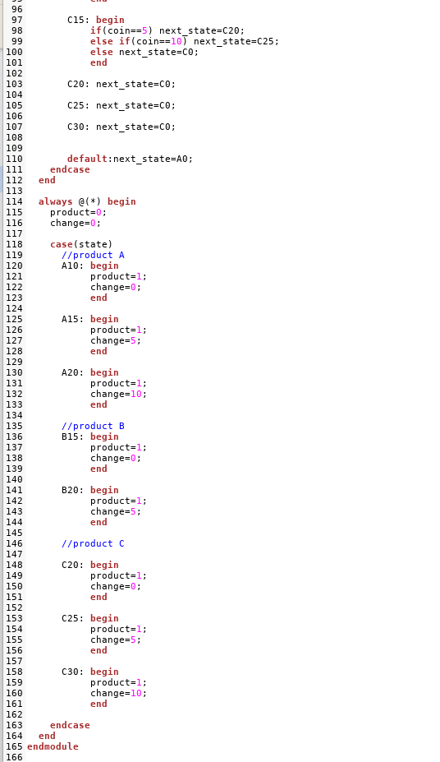

Slide 12
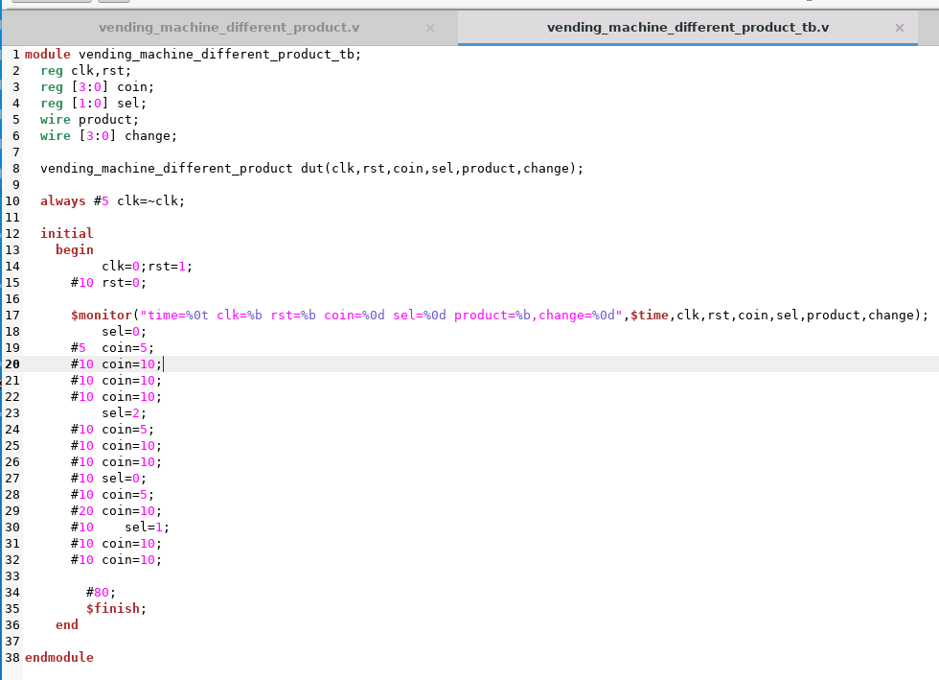
Test Bench

Slide 13
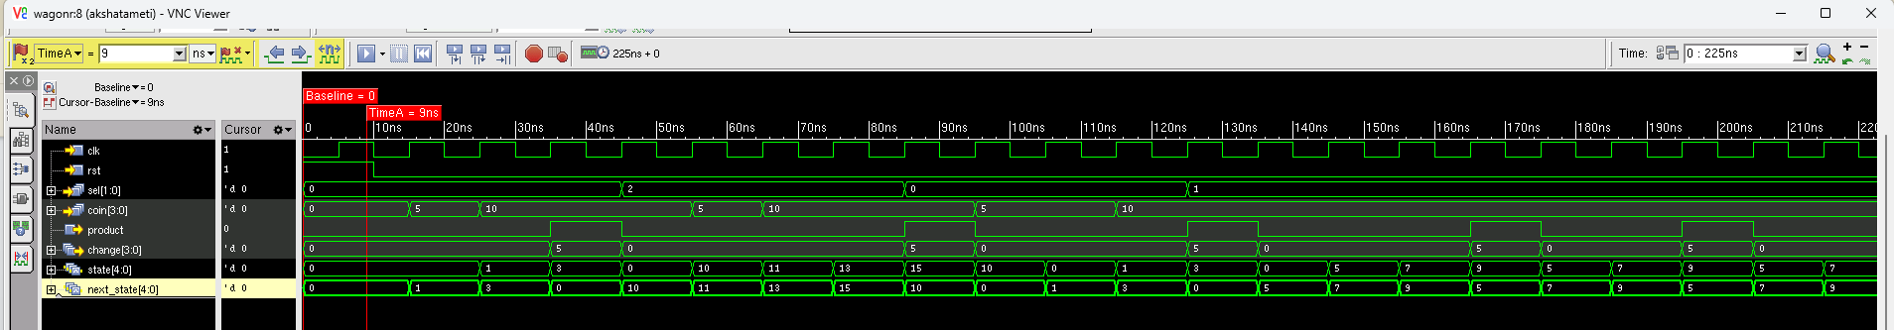
Waveform

Slide 14
Applications
Used in automatic vending machines for snacks, drinks, and coffee
Applied in ticket dispensing systems (bus, train, metro)
Used in ATM and cash handling systems
Implemented in parking ticket/payment machines
Applied in industrial automation systems for control operations

Slide 15
THANK YOU

